Slide 1
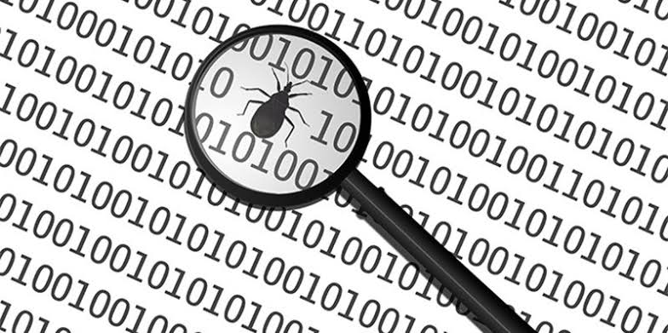
SOFTWARE BUGS

Slide 2
What is software Bugs?
A software bug is a problem causing a program to crash or produce invalid output.
The problem is caused by insufficient or erroneous logic.
A bug can be an error, mistake, defect or fault, which may cause failure or deviation from expected results.
Most bugs are due to human errors in source code or its design.
A program is said to be buggy when it contains a large number of bugs, which affect program functionality and cause incorrect results.

Slide 3
Some bugs might not have serious effects on the functionality of the program and may remain undetected for a long time.
A program might crash when serious bugs are left unidentified.
Another category of bugs called security bugs may allow a malicious user bypass access controls and obtain unauthorized privileges.

Slide 4
Some of the worst bugs in history include:
In the 1980s, bugs in the code controlling the machine called Therac-25, used for radiation therapy, lead to patient deaths.
In 1996, the $1.0 billion rocket called Ariane 5 was destroyed a few seconds after launch due to a bug in the on-board guidance computer program.
In 1962, a bug in the flight software for the Mariner I spacecraft caused the rocket to change path from the expected path.
In the 1990s, a bug was found in the new release of AT&T’s software control #4ESS long distance switches caused many computers to crash.

Slide 5
Importance of Understanding Software Bugs
1. Reliability and Quality Assurance
Bugs can lead to unexpected crashes, incorrect results, or other undesirable behaviors, which can undermine user trust and satisfaction
2. User Experience
Understanding and mitigating bugs can lead to an improved user experience by providing software that works as expected and is free from disruptive errors.
3. Security
Some software bugs can be exploited by malicious actors to gain unauthorized access, manipulate data, or execute code with unintended consequences

Slide 6
4. User Trust
Software users trust that the applications they use are reliable and secure. A high number of bugs can erode user trust and lead to a loss of customers or users
5. Efficiency and Productivity:
Software bugs can hinder productivity and efficiency, especially in business-critical applications. Understanding and fixing bugs can lead to smoother operations and cost savings.
6. Reputation:
The reputation of a software development team or organization is closely tied to the quality of their software. A history of buggy software can harm an organization's reputation.

Slide 7
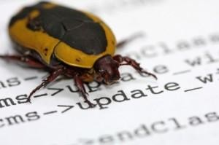
Reasons why bugs get into software
1. Last minute changes Developed by humans
Communication failure
Poor developing techniques 2. Lack of trained testing staff
Buggy third-party instruments Misapplication of technology
Unrealistic development timeframe

Slide 8
3. Miscommunication or no communication
Quite often, the requirements from the business is not communicated to the development team.
Product owners have an idea of what the feature should look like and how it should behave, but if not communicated properly to developers and testers, the finished product might not be as expected.
4. Software complexity
The complexity of current software applications can be difficult to comprehend for anyone without experience in modern-day software development.

Slide 9
5. Changing requirements
The end-user may not understand the effects of changes, or may understand and request them anyway – redesign, rescheduling of engineers, effects on other projects, work already completed that may have to be redone or thrown out, hardware requirements that may be affected, etc.

Slide 10
6. Poorly documented code
It’s tough to maintain and modify code that is badly written or poorly documented; the result is bugs.
In many organizations management provides no incentive for programmers to document their code or write clear, understandable, maintainable code.
7. Software development tools
Visual tools, class libraries, compilers, scripting tools, etc. often introduce their own bugs or are poorly documented, resulting in added bugs.

Slide 11
Defect Life Cycle In Detail
A Defect life cycle, also known as a Bug life cycle, is a cycle of a defect from which it goes through covering the different states in its entire life.
This starts as soon as any new defect is found by a tester and comes to an end when a tester closes that defect assuring that it won’t get reproduced again.

Slide 12
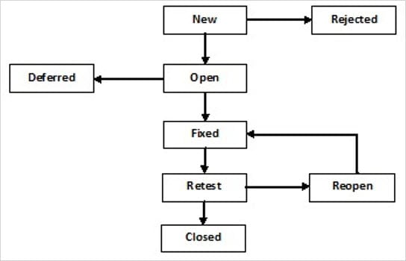
Defect Life Cycle In Detail

Slide 13
1. New: This is the first state of a defect in the Defect Life Cycle.
When any new defect is found, it falls in a ‘New’ state and validations and testing are performed on this defect in the later stages of the Defect Life Cycle.
2. Assigned: In this stage, a newly created defect is assigned to the development team for working on the defect.
This is assigned by the project lead or the manager of the testing team to a developer.
3. Open: Here, the developer starts the process of analyzing the defect and works on fixing it, if required.

Slide 14
If the developer feels that the defect is not appropriate then it may get transferred to any of the below four states namely Duplicate, Deferred, Rejected or Not a Bug-based upon the specific reason.
4. Fixed: When the developer finishes the task of fixing a defect by making the required changes then he can mark the status of the defect as ‘Fixed’.
5. Pending Retest: After fixing the defect, the developer assigns the defect to the tester for retesting the defect at their end and till the tester works on retesting the defect, the state of the defect remains in ‘Pending Retest’.

Slide 15
6. Retest: At this point, the tester starts the task of working on the retesting of the defect to verify if the defect is fixed accurately by the developer as per the requirements or not.
7. Reopen: If any issue still persists in the defect then it will be assigned to the developer again for testing and the status of the defect gets changed to ‘Reopen’.

Slide 16
8. Verified: If the tester does not find any issue in the defect after being assigned to the developer for retesting and he feels that if the defect has been fixed accurately then the status of the defect gets assigned to ‘Verified’.
10. Closed: When the defect does not exist any longer then the tester changes the status of the defect to ‘Closed’.

Slide 17
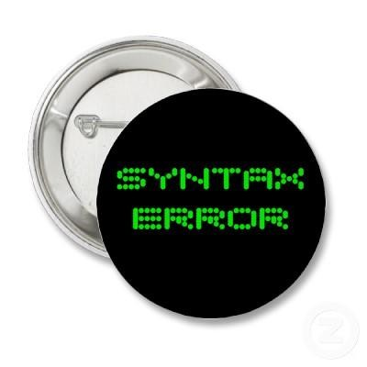


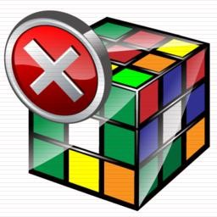



Types of software bugs

Slide 18
There is no software without bugs. Every day testers all over the world encounter new and new software defects and issues.
But some of them have become sort of common as they appear more frequently than others.
1. Incorrect calculations
This type of problem can be caused by a lot of reasons, e.g., wrong algorithm, data type mismatch or just coding errors.
Sometimes, a cost of these bugs can be very high.
History knows a lot of examples when a wrong number provoked accidents or huge financial losses.

Slide 19
2. Functional errors
All the functionality of any program should operate correctly. It means that an expected result of operations should coincide with an actual one.
But often they don’t.
As far as there are programs, which have quite a big range of functions, there is a great probability of bug omission.
3. Error handling errors
All the software problems occurred during an interaction with the user should be handled successfully.
Besides, a user should be clearly informed about the cause of the problem and possible ways out.

Slide 20
If a user types something incorrectly, he / she should receive a quite informative message not to do the same mistake again
4. Communication errors
Software should be easy to use and provide all necessary instructions and recommendations for users to interact with a program.
Sometimes it happens that a new feature is implemented, but you cannot find it even using documentation.
5. Syntactic errors
We all are humans and may make grammar mistakes. Especially, it happens when the product is translated into different languages.
While testing GUI of the product, it is important to switch languages and check the correspondence of the elements with the documentation.

Slide 21
6. Missing command errors
Sometimes it happens, that you cannot close a pop-up window without performing some actions, even if you don’t want to.
This is missing command errors.
That can be not only the absence of button but also the absence of a logical option
7. Boundary related errors
In our life, everything has a limit.
The same we can say about software resources.
Maximum text size, maximum number of simultaneous users, memory limit allocated for one element – if all of this is not anticipated by developers it will definitely cause problems.

Slide 22





What are the consequence's of bugs in a software?

Slide 23
How are bugs fixed?
1. Bug identification
2. Bug reporting: Once a bug is identified, it needs to be reported effectively.
3. Bug prioritization: Not all bugs have the same impact on the software or its users
4. Bug assignment: Bugs are typically assigned to developers or development teams for resolution. The developer or team responsible for fixing the bug will analyze it to determine the root cause.
5. Bug Analysis and Fixing: Developers analyze the bug, identify the underlying cause, and then proceed to fix it. The fixing process may involve modifying code, configuration settings, or data.

Slide 24
6. Regression Testing
After a bug is fixed, regression testing is performed. This type of testing ensures that the bug fix didn't introduce new issues or affect other parts of the software
7. Verification and Validation
Verification is the process of ensuring that the bug fix successfully resolves the reported issue.
8. Release and Deployment
Once a bug is fixed and verified, the software can be released or deployed. The bug fix is typically included in the next software release or update.
9. Documentation
Keeping records of fixed bugs, their solutions, and testing outcomes is essential for future reference

Slide 25
10. Bug Prevention:
To reduce the occurrence of bugs, development teams can implement best coding practices, conduct code reviews, and use automated testing tools.
Preventing bugs is more cost-effective than fixing them later in the development cycle.

